Slide 1
Fourier Transforms
Notes:
Outline:
Central Scientific Problem – Artificial Intelligence
Machine Learning:
Definition
Specifics
Requirements
Existing Solutions and their limitations
Multiresolution Approximation: Limitation
Our Approach. Results. Binarization. Plans.

Slide 2
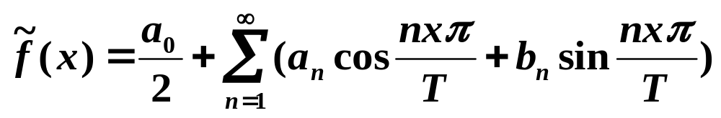

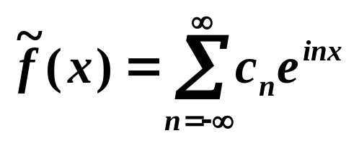
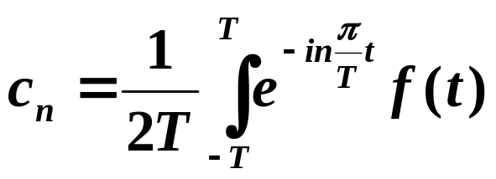
Fourier Series in exponential form
Consider the Fourier series of the 2T periodic function:
Due to the Euler formula
It can be rewritten as
With the decomposition coefficients calculated as:
(1)
(2)
Notes:
Outline:
Central Scientific Problem – Artificial Intelligence
Machine Learning:
Definition
Specifics
Requirements
Existing Solutions and their limitations
Multiresolution Approximation: Limitation
Our Approach. Results. Binarization. Plans.

Slide 3
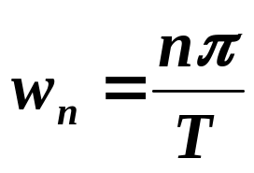
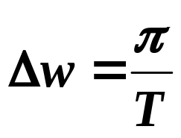
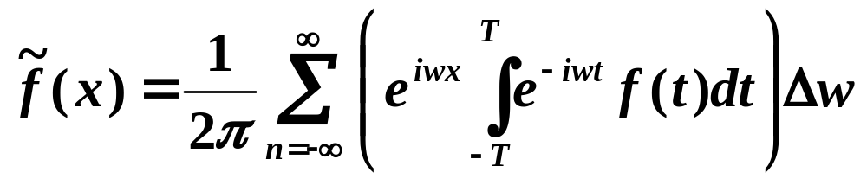
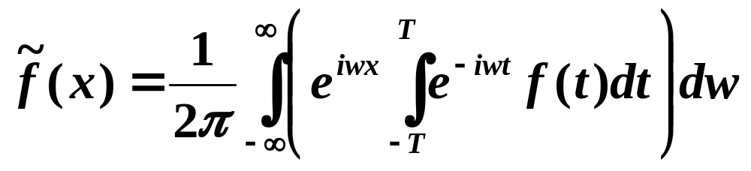
Fourier transform
The frequencies are and
Therefore (1) and (2) are represented as
Since, on one hand the function with period T has also the periods kT for any integer k, and on the other hand any non-periodic function can be considered as a function with infinite period, we can run the T to infinity, and obtain the Riemann sum with ∆w→∞, converging to the integral:
(3)
(4)
Notes:
Outline:
Central Scientific Problem – Artificial Intelligence
Machine Learning:
Definition
Specifics
Requirements
Existing Solutions and their limitations
Multiresolution Approximation: Limitation
Our Approach. Results. Binarization. Plans.

Slide 4
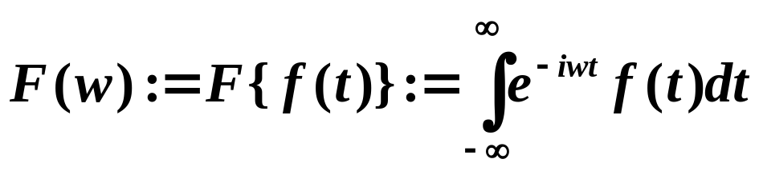
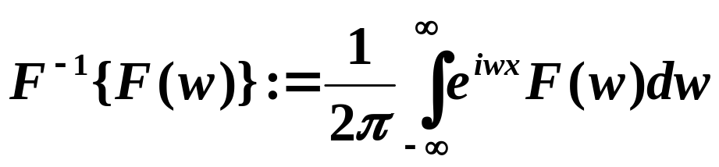
Fourier transform definition
The integral (4) suggests the formal definition:
The funciotn F(w) is called a Fourier Transform of function f(x) if:
The function
Is called an inverse Fourier transform of F(w).
(5)
(6)
Notes:
Outline:
Central Scientific Problem – Artificial Intelligence
Machine Learning:
Definition
Specifics
Requirements
Existing Solutions and their limitations
Multiresolution Approximation: Limitation
Our Approach. Results. Binarization. Plans.

Slide 5
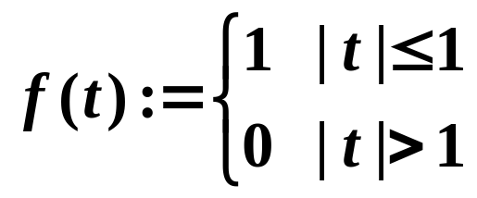
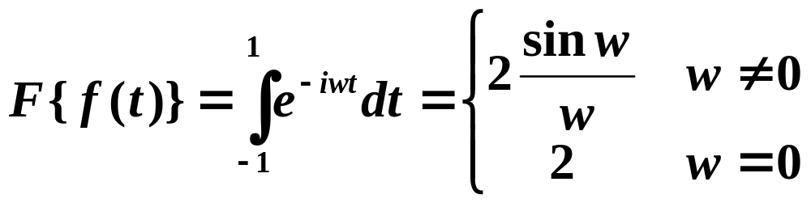
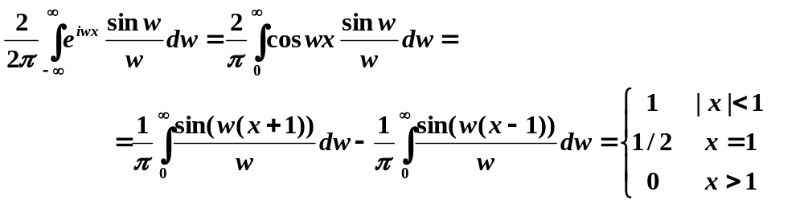
Example 1
The Fourier transform of
is
The inverse Fourier transform is
Notes:
Outline:
Central Scientific Problem – Artificial Intelligence
Machine Learning:
Definition
Specifics
Requirements
Existing Solutions and their limitations
Multiresolution Approximation: Limitation
Our Approach. Results. Binarization. Plans.

Slide 6
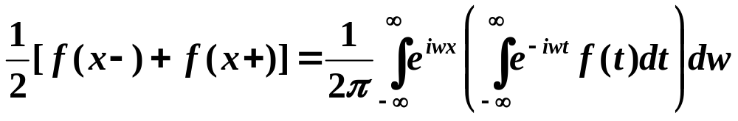
Fourier Integral
If f(x) and f’(x) are piecewise continuous in every finite interval, and f(x) is absolutely integrable on R, i.e.
converges, then
Remark: the above conditions are sufficient, but not necessary.
Notes:
Outline:
Central Scientific Problem – Artificial Intelligence
Machine Learning:
Definition
Specifics
Requirements
Existing Solutions and their limitations
Multiresolution Approximation: Limitation
Our Approach. Results. Binarization. Plans.

Slide 7
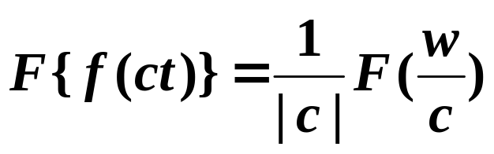
Properties of Fourier transform
1 Linearity:
For any constants a, b the following equality holds:
Proof is by substitution into (5).
Scaling:
For any constant c, the following equality holds:
Notes:
Outline:
Central Scientific Problem – Artificial Intelligence
Machine Learning:
Definition
Specifics
Requirements
Existing Solutions and their limitations
Multiresolution Approximation: Limitation
Our Approach. Results. Binarization. Plans.

Slide 8
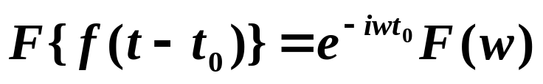
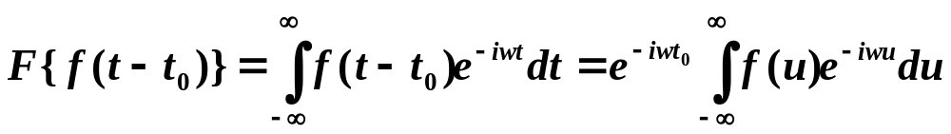
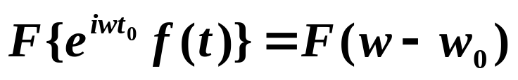
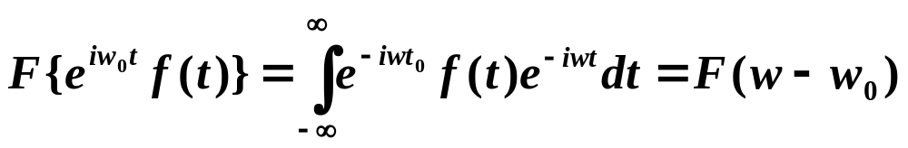
Properties of Fourier transform 2
Time shifting:
Proof:
Frequency shifting:
Proof:
Notes:
Outline:
Central Scientific Problem – Artificial Intelligence
Machine Learning:
Definition
Specifics
Requirements
Existing Solutions and their limitations
Multiresolution Approximation: Limitation
Our Approach. Results. Binarization. Plans.

Slide 9

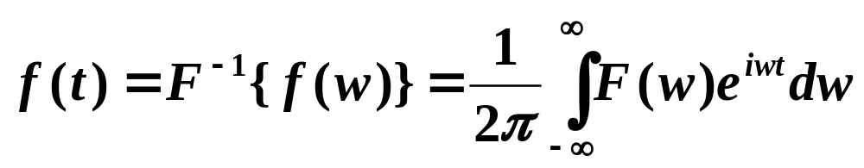
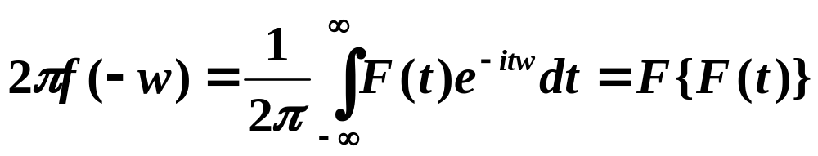
Properties of Fourier transform 3
Symmetry:
Proof:
The inverse Fourier transform is
therefore
Notes:
Outline:
Central Scientific Problem – Artificial Intelligence
Machine Learning:
Definition
Specifics
Requirements
Existing Solutions and their limitations
Multiresolution Approximation: Limitation
Our Approach. Results. Binarization. Plans.

Slide 10
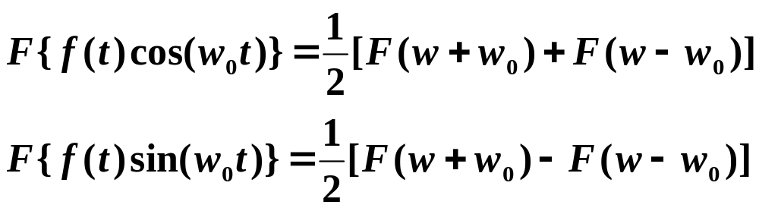
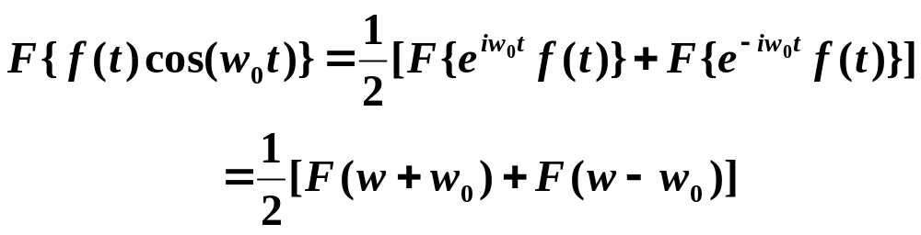
Properties of Fourier transform 4
Modulation:
Proof:
Using Euler formula, properties 1 (linearity) and 4 (frequency shifting):
Notes:
Outline:
Central Scientific Problem – Artificial Intelligence
Machine Learning:
Definition
Specifics
Requirements
Existing Solutions and their limitations
Multiresolution Approximation: Limitation
Our Approach. Results. Binarization. Plans.

Slide 11
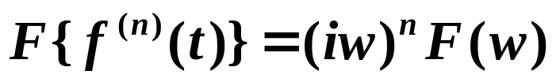
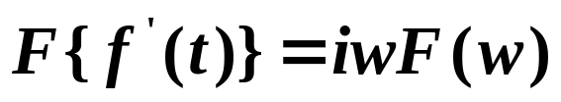
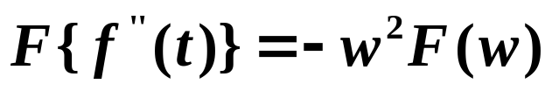
Differentiation in time
Transform of derivatives
Suppose that f^{(n)} is piecewise continuous, and absolutely integrable on R. Then
In particular
and
Proof:
From the definition of F{f^{(n)}(t)} via integrating by parts.
Notes:
Outline:
Central Scientific Problem – Artificial Intelligence
Machine Learning:
Definition
Specifics
Requirements
Existing Solutions and their limitations
Multiresolution Approximation: Limitation
Our Approach. Results. Binarization. Plans.

Slide 12
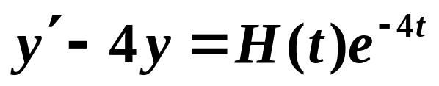
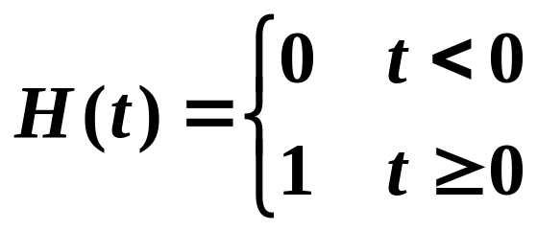
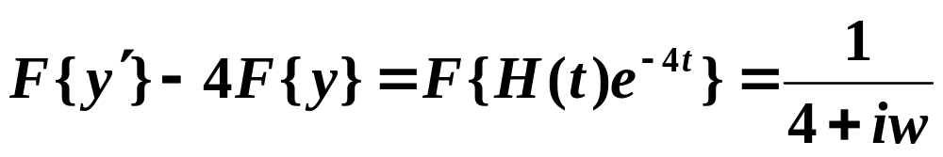
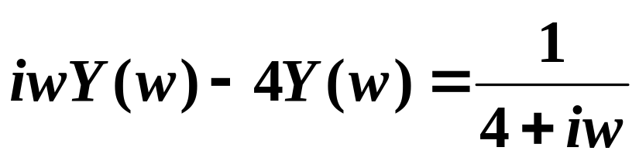
Example 2
The property of Fourier transform of derivatives can be used for solution of differential equations:
Setting F{y(t)}=Y(w), we have
Notes:
Outline:
Central Scientific Problem – Artificial Intelligence
Machine Learning:
Definition
Specifics
Requirements
Existing Solutions and their limitations
Multiresolution Approximation: Limitation
Our Approach. Results. Binarization. Plans.

Slide 13
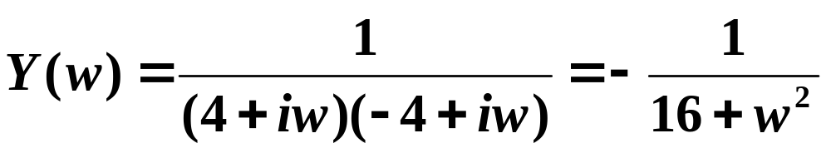
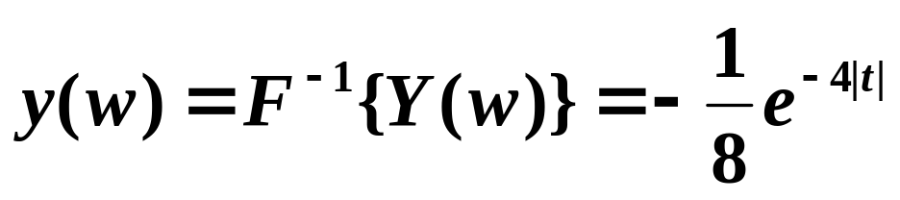
Example 2
Then
Therefore
Notes:
Outline:
Central Scientific Problem – Artificial Intelligence
Machine Learning:
Definition
Specifics
Requirements
Existing Solutions and their limitations
Multiresolution Approximation: Limitation
Our Approach. Results. Binarization. Plans.

Slide 14
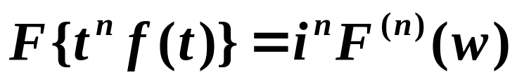
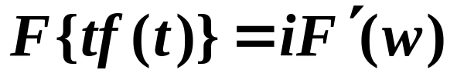
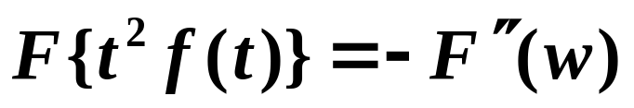
Frequency Differentiation
In particular and
Which can be proved from the definition of F{f(t)}.
Notes:
Outline:
Central Scientific Problem – Artificial Intelligence
Machine Learning:
Definition
Specifics
Requirements
Existing Solutions and their limitations
Multiresolution Approximation: Limitation
Our Approach. Results. Binarization. Plans.

Slide 15
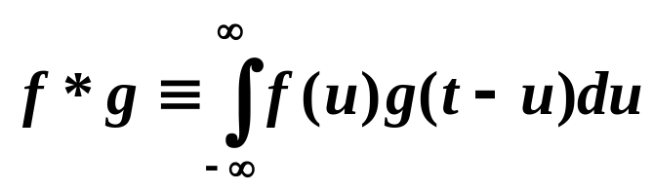
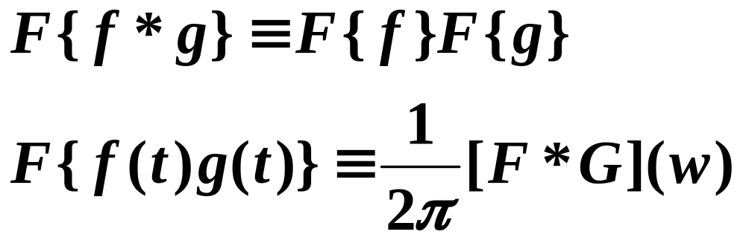
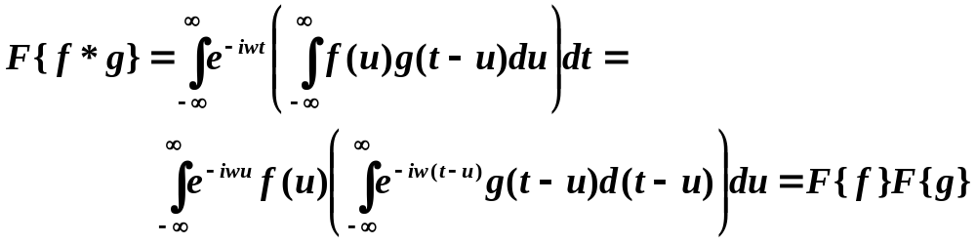
Convolution
The convolution of two functions f(t) and g(t) is defined as:
Theorem:
Proof:
Notes:
Outline:
Central Scientific Problem – Artificial Intelligence
Machine Learning:
Definition
Specifics
Requirements
Existing Solutions and their limitations
Multiresolution Approximation: Limitation
Our Approach. Results. Binarization. Plans.

